Slide 1

Text Book With GUI

Slide 2

Supervisored: Prof. Ahmed Emam
Team Name : Unique team
Ahmed Talat Ali (Leader) 221101084
Ahmed Nader Agiz 221101008
Maged Mohamed bltagy 221101048

Slide 3
Text GUI With Python
Sometimes people need to make some operations to a specific text as quickly as possible and in the quickest possible way.
First, we are working on a GUI for text project. We used the Tkinter library, where we perform some operations on the entered text in the form of a specific button that the user presses.

Slide 4
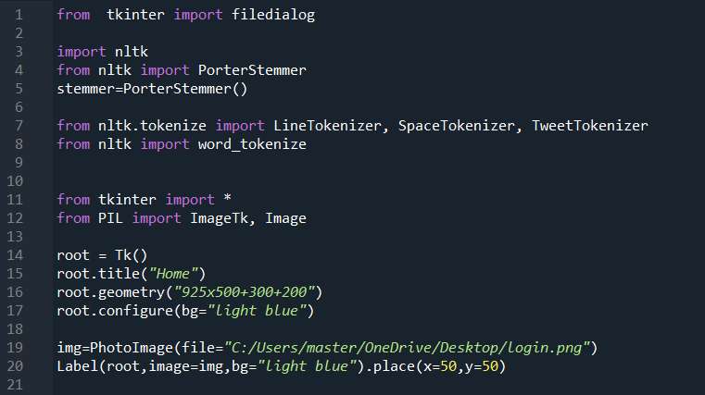
Libraries have been used

Slide 5
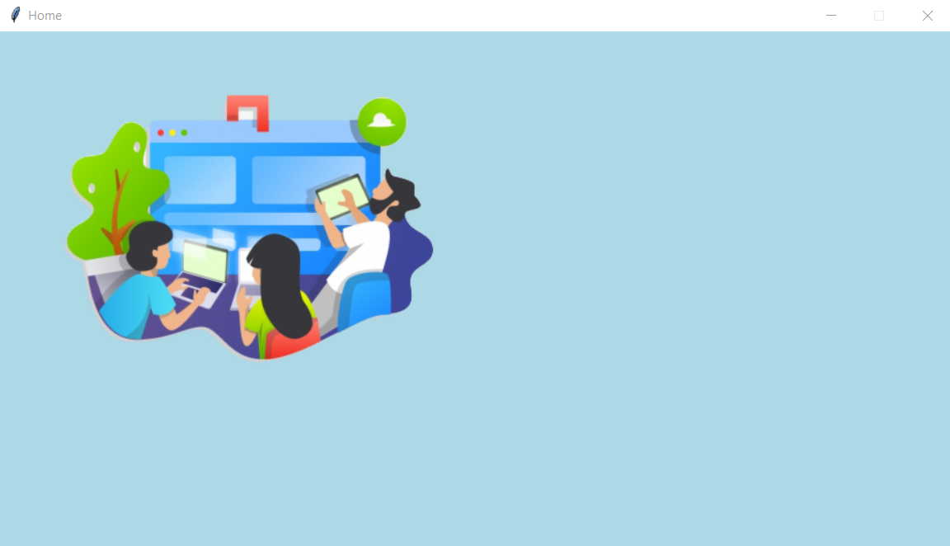
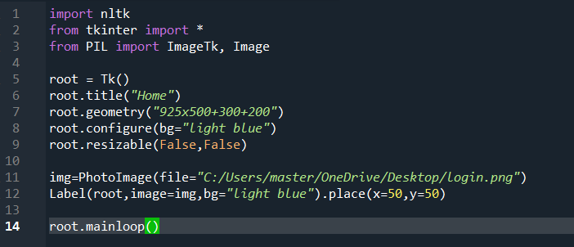
Graphical User Interface
The main interface that the user works with

Slide 6
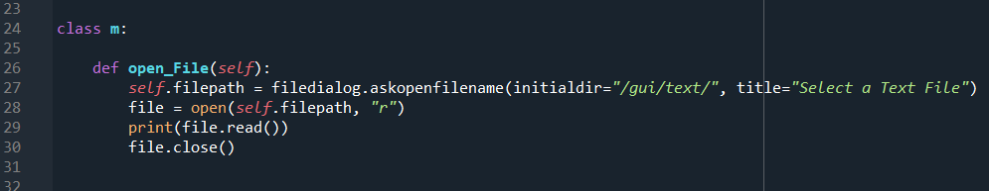
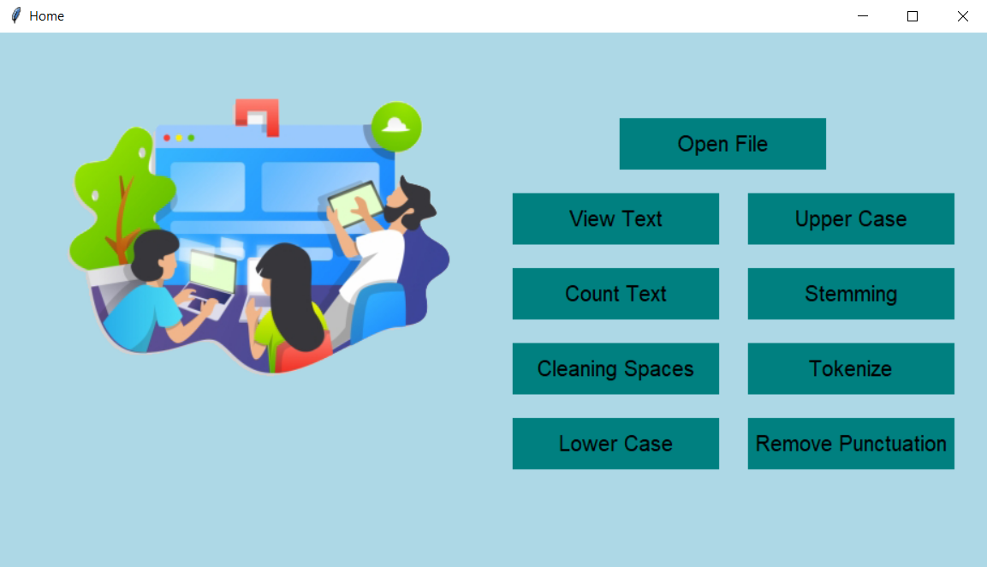
open_File
It selects the text file that you want to work on

Slide 7
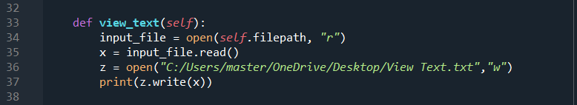
view_text
Displays the original text file

Slide 8
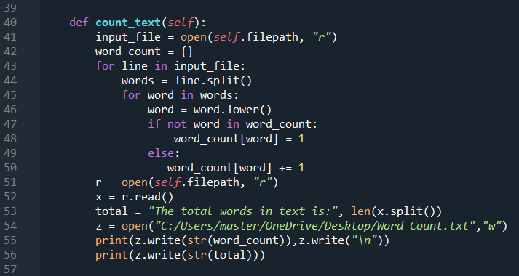
count_text
Counts and prints the words in the dictionary, prints the number of occurrences of each word, and prints the total number of words in the file

Slide 9
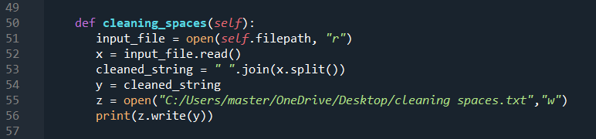

cleaning_spaces
It removes extra spaces and adds one space between each word

Slide 10
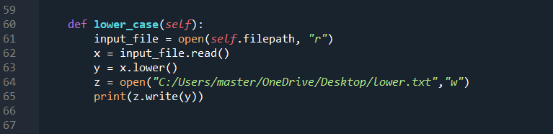
lower_case
Makes all words in the file lower case

Slide 11
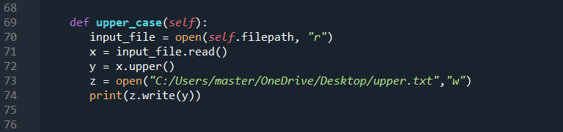
upper_case
Makes all words in the file upper case

Slide 12
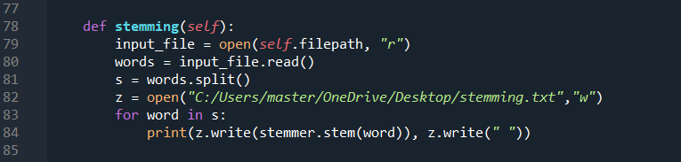
stemming
It reduces the word to its root or base form. It is a kind of normalization of words.

Slide 13
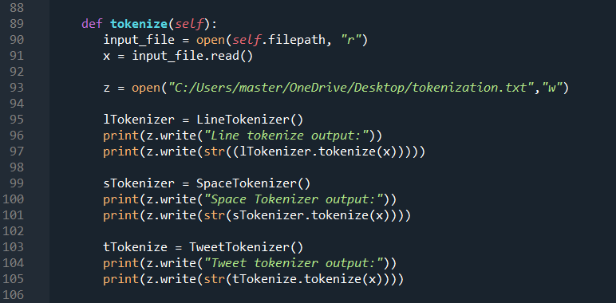
tokenize
It breaks down the flow of text into words, phrases, symbols, or other meaningful elements called tokens.

Slide 14
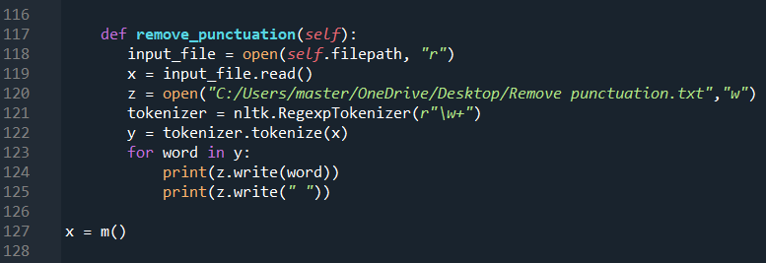
remove_punctuation
It removes all punctuation marks from the text

Slide 15
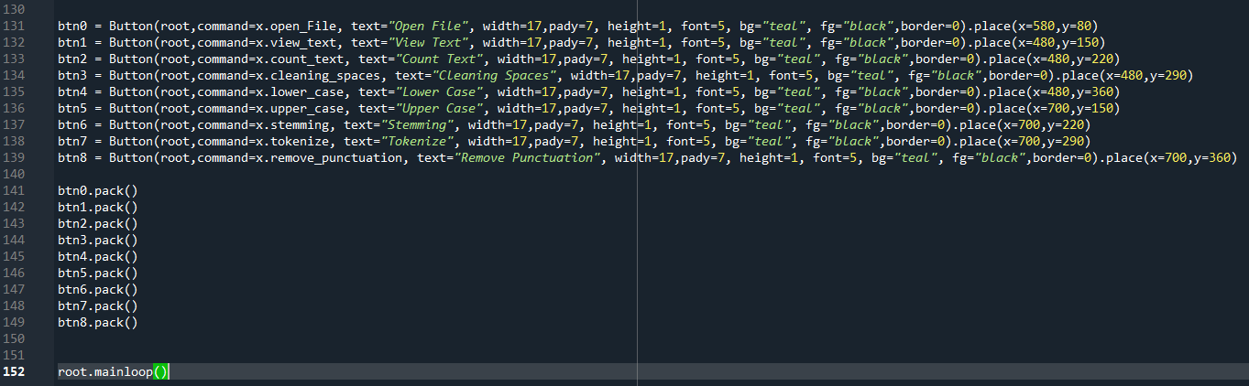
These are the definitions of all the buttons for the operations that the user works with

Slide 16
Thank You.

